Slide 1
Automatic Coconut Breaking, Scraping, and Grinding Machine
IN 1900 (ICT Project)
Project Progress Presentation
Group No:15

Slide 2





Group Members
 | Name | Registration Number | Photo
Group leader | Nusky M.N.N. | 204146L
Member 1 | Banu A.G.S. | 204018X
Member 2 | Karunaweera R.L. | 204096G
Member 3 | Kumarasingha H.J.A. | 204108A
Member 4 | Lamahewage D.R. | 204114M

Slide 3
Outline
Problem in brief
Project Aim and Objectives
Proposed Solution
3D Diagram
3D Animation
Circuit Diagram
Full Code
Resource Requirements
Cost Estimation
Testing and implementation

Slide 4
Problem in brief
Hard & risky to break the coconut using a knife with our hand.
Difficult with scraping the coconut for a long time holding with the hands.
Taking time to cut, scrape and grind the coconut separately.
Have risk with handling the coconut through an unsafe machine.

Slide 5
Project Aim and Objectives
Aim
Design and develop an automated machine for the process of coconut breaking, scraping & grinding with a safety mechanism.
Objectives
To break the coconut and get the water separately.
To scrape the coconut.
To grind the coconut.
To maintain the process safely.

Slide 6
Proposed Solution
Inputs
Process
Outputs
Text and numbers
Display
Numbers
Analyze the user inputs and starting the coconut breaking process.
Sound
Keypad
Buzzer
Distance (Water level)
Rotate the motor
DC motor
Rotating the cut disk, coconut scraper and blender
Ultrasonic sensor
Analyze the water level of the water tank and send signals to the buzzer.
Detection (of the cut disk)
Rotate the motor
Servo motor
Pointing the coconut fixing handle towards the coconut scraper
IR sensor
Starting the process of coconut scraping and grinding after analyzing the signal of IR sensor and send signals to Servomotor, DC motor and blender system.
Detection (of the color)
Rotate the motor
Color Sensor
Stepper motor
Moving the cut disk up and down.
Grinding
Blender system
Atmega 32 Microcontroller

Slide 7
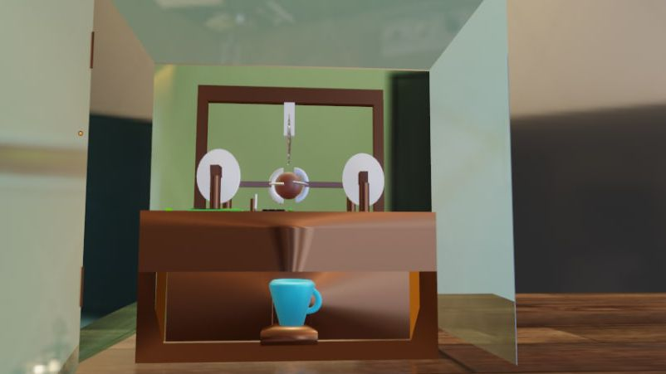
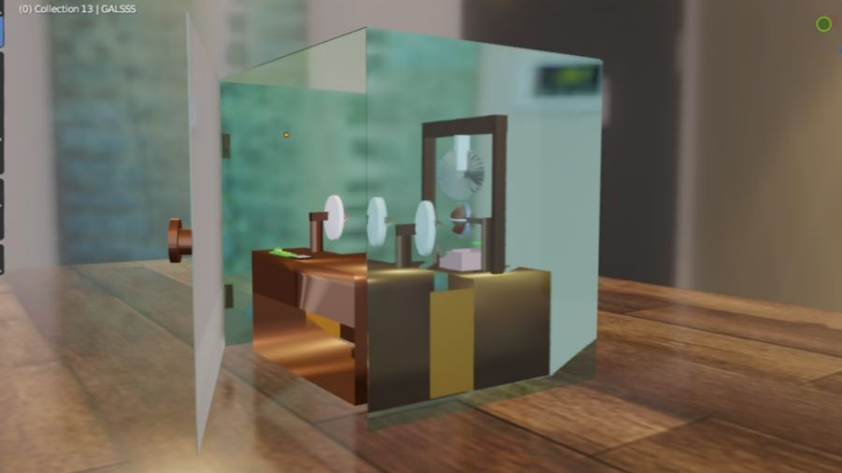
3D Diagram
Glass box
Blender
Figure 2 -Front view
Figure 3 –Right side view

Slide 8
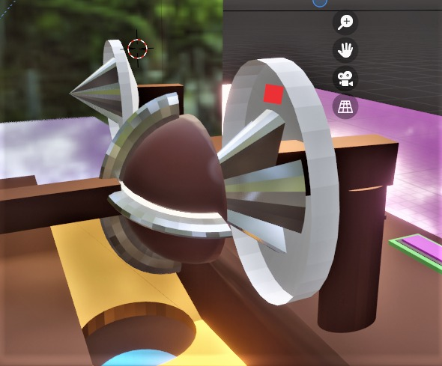
3D Diagram
Color sensor
Figure 4 -Side view

Slide 9
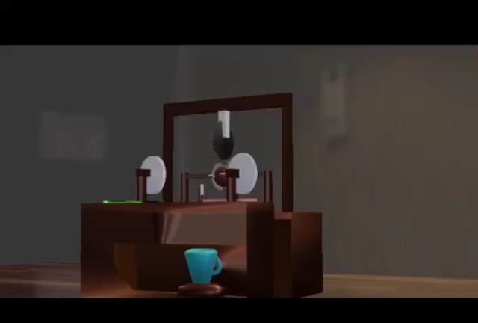
3D Animation
Link for 3D Animation: https://drive.google.com/file/d/1ILcT4oXj9GX8DXqPTRbnsRM1xtLKLiQE/view?usp=drivesdk

Slide 10
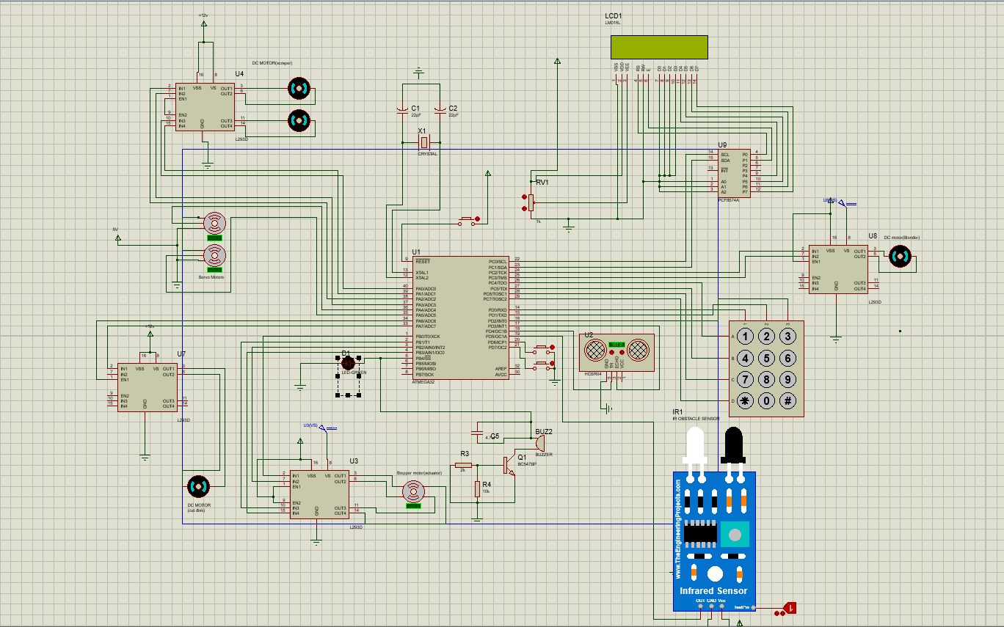
Circuit Diagram
Figure 5 –Circuit Diagram

Slide 11
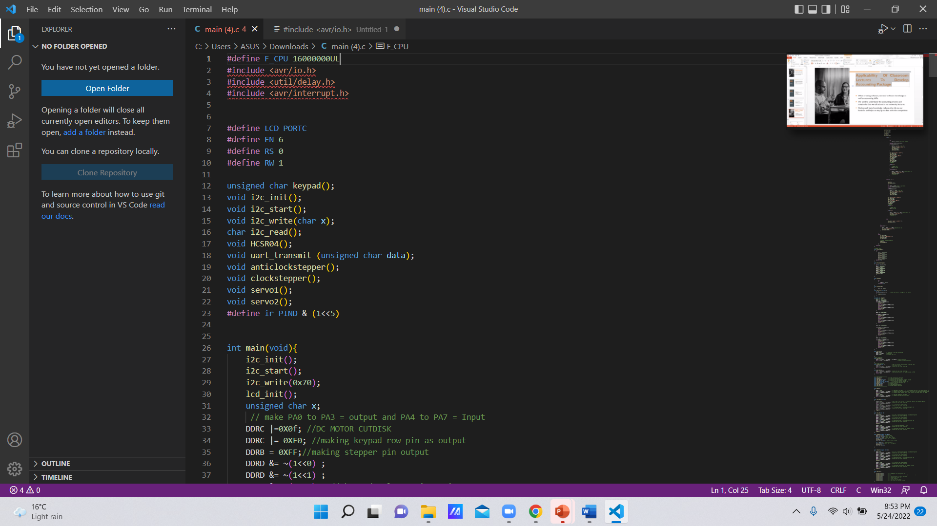
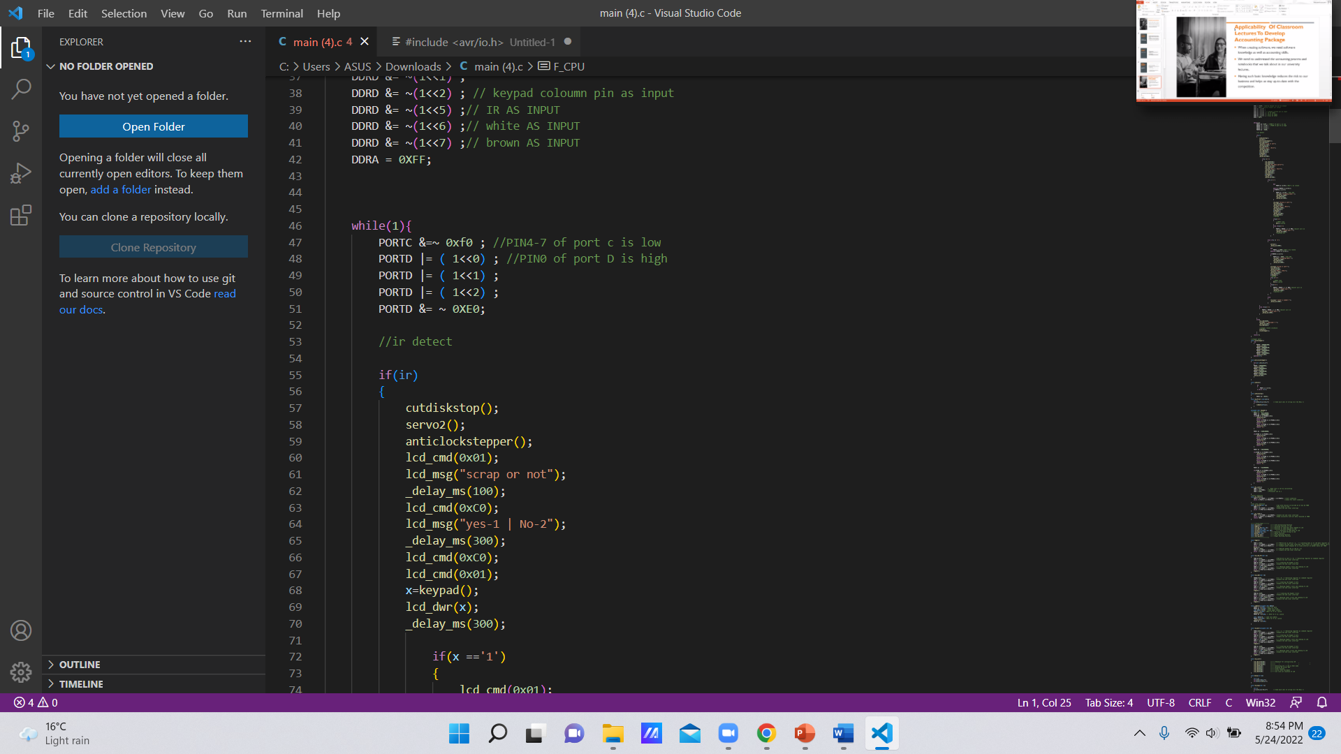
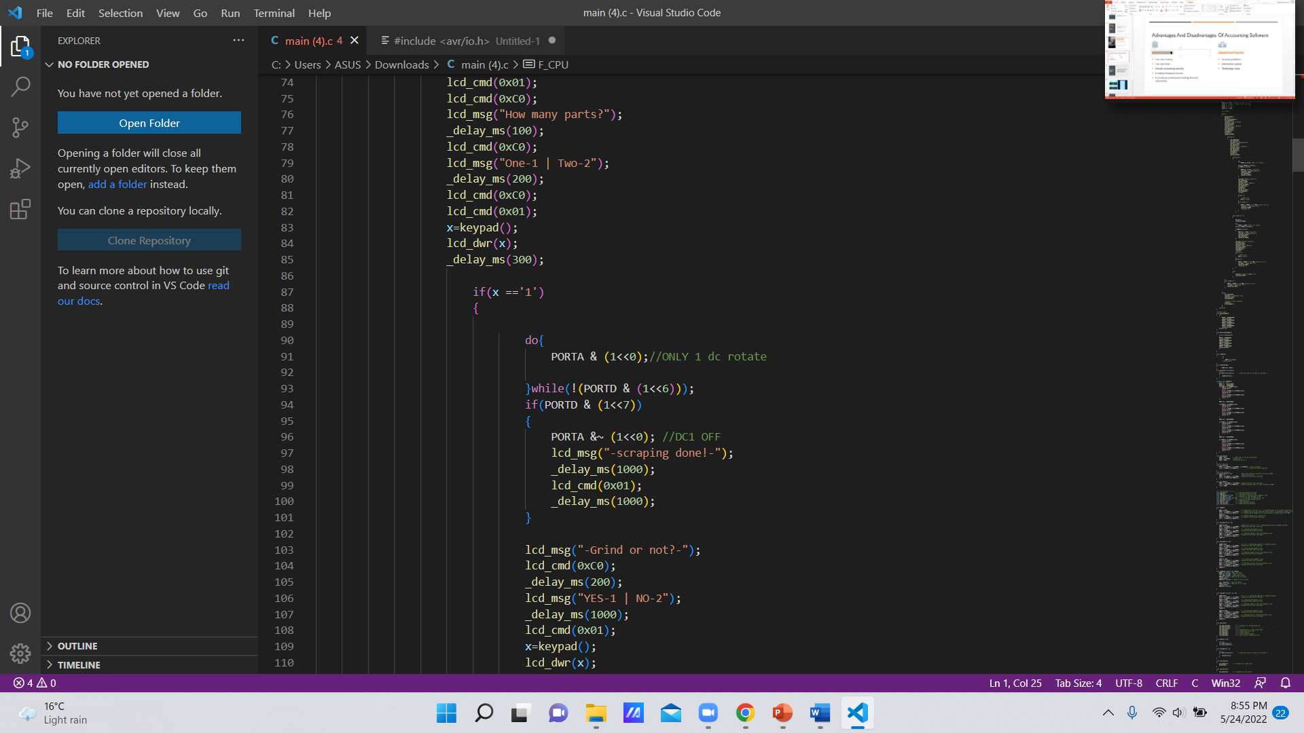
Full Code

Slide 12
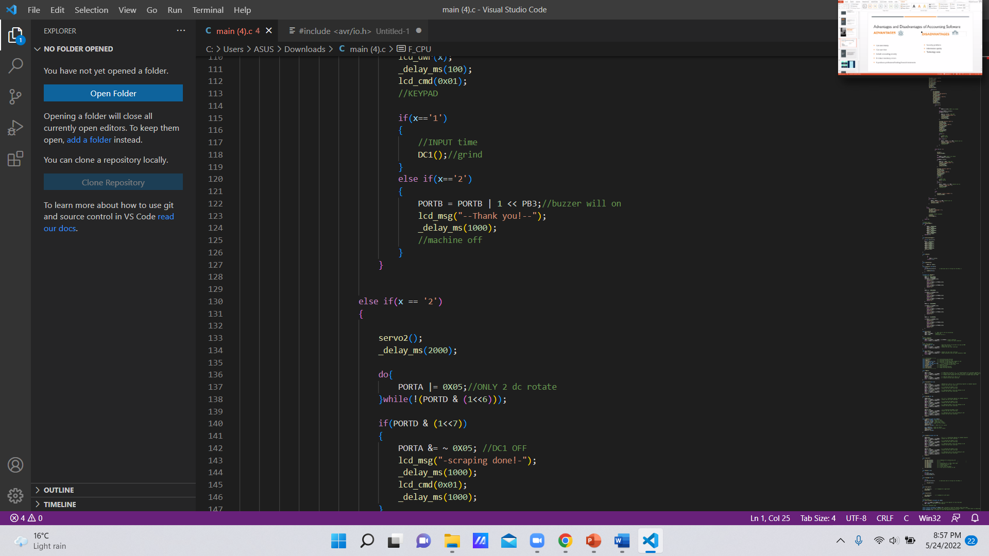
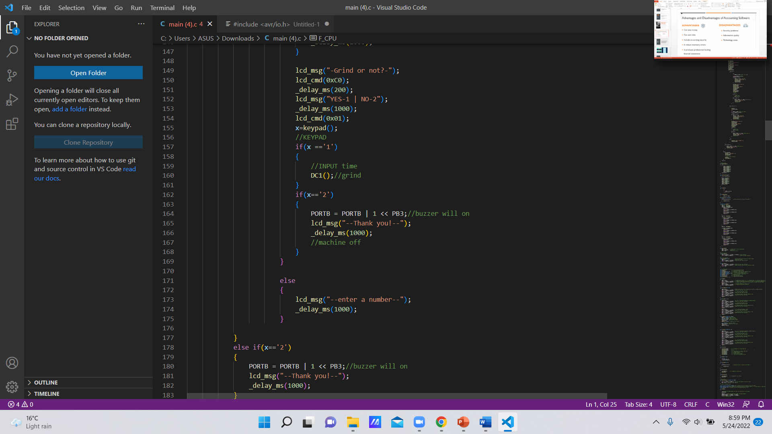
Full Code
…

Slide 13
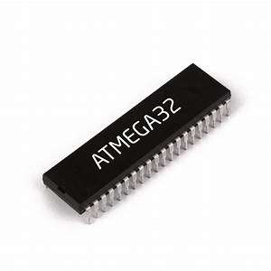

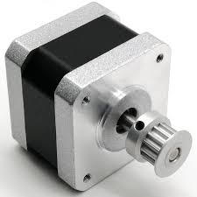
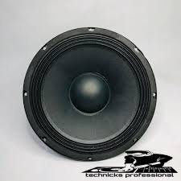
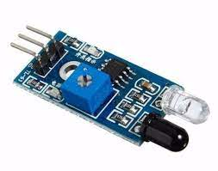
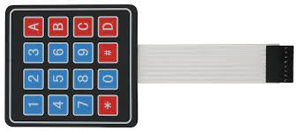
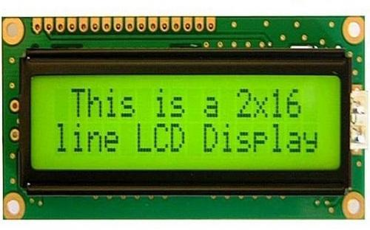
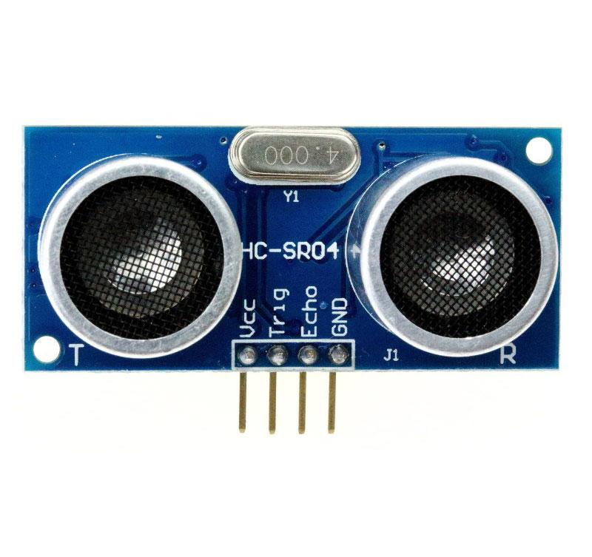
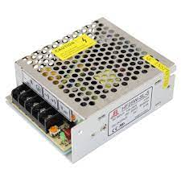
Resources Requirements
Software:
Atmel Studio
Proteus software
Blender software
Hardware:
Microcontroller: Atmega32
IR Sensor
Ultrasonic sensor
Keypad
Buzzer
Display
Stepper motor
Servo motor
DC motor
Push button
Blender system

Slide 14
Cost Estimation
Item | Quantity | Price (Rs) | Subtotal (Rs)
Atmega32 | 1 | 540 | 540
IR sensor | 1 | 25 | 25
Ultrasonic sensor | 1 | 200 | 200
Buzzer | 1 | 300 | 300
Keypad (3*3) | 1 | 160 | 160
Display (2*16) | 1 | 600 | 600
Push button | 1 | 10 | 10
Servo motor | 2 | 500 | 1000
Stepper motor | 1 | 1250 | 1250
DC motor | 4 | 1250 | 5000
Blender system | 1 | 3500 | 3500
Finishing | 1 | 4000 | 4000
Total |  |  | 16585
Figure 6 – Estimated cost

Slide 15

Thank you!
Questions?

